Slide 1

Bract’s Vishwakarma Institute of Information Technology Department of Engineering and Applied Science ET10203A : BASIC ELECTRICAL ENGINEERING A project on “Study of Power Consumption of computer and Laptops” Academic Year : 2021-22 Semester: II Batch: J1 Submitted for the fulfillment of Project Based Learning by:
Roll No. | PRN | Name of student | Contact No.
1001 | 22110010 | Nachiket Balame | 9766109185
1008 | 22110116 | Atharva Gawas | 8855847610
1017 | 22110260 | Sandesh Kangude | 8668803417
1021 | 22110378 | Rajat Bhalerao | 8956068215
1022 | 22110394 | Jayesh Jaiswal | 7499729399
1023 | 22110410 | Omkar Aher | 9860289857

Slide 2
Contents
Introduction
Sub-topics of power consumptions :
2.1. Statistics of usage
2.2. Power Consumption in different screens
2.3. Processor Power vs. Power Consumption
2.4. Power loss in CPU
2.5. Power Consumption in GPU
2.6. Methods to reduce power consumption
Conclusions
References

Slide 3
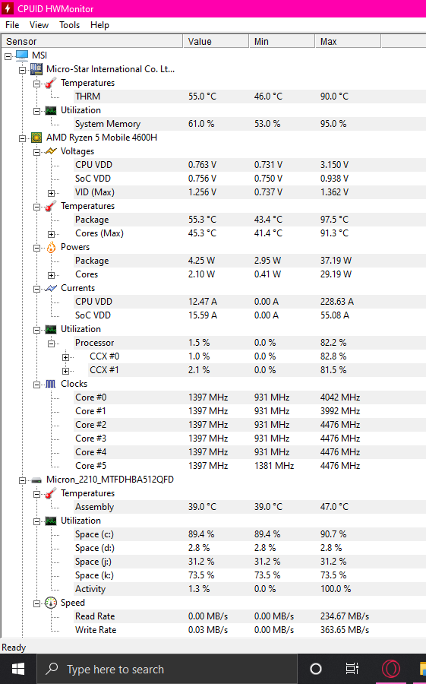
Introduction:
Over the past few decades, human beings have increasingly adopted different types of personal computers including desktop computers, laptops, tablets and smart phones. Electric energy consumption is the form of energy consumption that uses electrical energy.
The energy used by equipment is always more than the energy really needed. This is because no equipment is 100% efficient. Power is wasted as heat, vibrations and/or electromagnetic radiation. For example, a light bulb does not only convert electric power into light; it also makes some heat.
Case Study of
Overall Laptop Components
1001_Nachiket Balame, Department of Engineering and Applied Sciences, VIIT, Pune-48

Slide 4
2.1. Statistics of usage -
Desktop computers are used for an average of 7.3 hours per day (Average = 4.2 h/d), while laptops are used for a mean 4.8 hours per day (Average = 2.1 h/d). Annual energy consumption (AEC) for desktops is estimated to be 194 kWh/yr (Average = 125 kWh/yr), and for laptops 75 kWh/yr (Average = 31 kWh/yr).
Laptops typically consume 20-50 Watts of electricity that can be trimmed down in power saver modes. Desktops on the other hand use about 60-200 Watts of electricity.
Hard Drive Power Consumption: 5 Watts to 6.8 Watts. Solid-State Drive (SSD) Power Consumption: 1.6 to 4.1 Watts.
2.2. Power Consumption in different screens -
A CRT (Cathode Ray Tube) screen consumes more than LCD (Liquid Crystal Display) screens. LCD screens can save up to 75% electricity over a CRT screen. A desktop also requires a UPS (Uninterruptible Power Supply) to keep it running during power loses which can eat significant amount of electricity.
The laptops whose sizes range from 12 to 15 inches usually use around 60 watts per hour while the laptops that have a 17-inch or above screen consume 70 watts or higher on average.
1001_Nachiket Balame & 1017_Sandesh Kangude, Department of Engineering and Applied Sciences, VIIT, Pune-48

Slide 5
2.2. Power Consumption in different screens -
Desktops on the other hand use about 60-200 Watts of electricity. LED & LCD screens use the same TFT LCD (thin film transistor liquid crystal display) technology for displaying images on the screen, when a product mention LED it is referring to the backlighting.
Older LCD monitors used CCFL (cold cathode fluorescent) backlighting which is generally 20-30% less power efficient compared to LED-backlit LCD displays. TN stands for twisted nematic. This is a type of LED (a form of LCD) panel display technology.
TN panels are characterized as being the fastest and cheapest among the other main types of display panels, VA (vertical alignment) and IPS (in-plane switching).
As such, they work great for gaming monitors and gaming laptops. However, TN panels also offer the worst viewing angles and color when compared to VA and IPS panels.
Screen Size | LED | LCD | CRT | Plasma
15 inches | 15 | 18 | 65 | ---
17 inches | 18 | 20 | 75 | ---
19 inches | 20 | 22 | 80 | ---
20 inches | 24 | 26 | 90 | ---
21 inches | 26 | 30 | 100 | ---
22 inches | 30 | 40 | 110 | ---
24 inches | 40 | 50 | 120 | ---
30 inches | 50 | 60 | --- | 150
32 inches | 55 | 70 | --- | 160
37 inches | 60 | 80 | --- | 180
42 inches | 80 | 120 | --- | 220
50 inches | 100 | 150 | --- | 300
Power Consumption Comparison Between LED, LCD, CRT & Plasma
2.2.1. Source : https://energyusecalculator.com/electricity_lcdleddisplay.htm
1017_Sandesh Kangude, Department of Engineering and Applied Sciences, VIIT, Pune-48

Slide 6
2.3. Processor Power vs. Power Consumption -
1. Power is used in two senses in the computer world.
2. Power is often talked about as the overall processing power eg the GHz. But as important is power consumption. That second meaning is expressed in watts. More watts is not better or worse — it’s just the amount of power it takes to run the processor at full capacity.
3. However, the higher the number, the more your electricity bill is ticking up and the more heat is being generated.
4. Processors that perform tasks at a greater speed inherently require more power, but more and more are optimizing their energy efficiency.
1008_Atharva Gawas, Department of Engineering and Applied Sciences, VIIT, Pune-48

Slide 7
2.4. Power loss in CPU:
1. Some Power goes to transmitting data over the network.
2. There is also energy used in in turning memory bits on and off, plus the CPU memory must continue to use power to maintain the current memory even when nothing else is being processed.
3. Computation is heat. In fact, all the power input ends up as heat eventually.
4. Computation is organized heat. In the form of data. What we consider to be waste heat is just disorganized data and not used for computation.
5. Ideally a computer which doesn't perform any tasks consumes no energy, but there are always tiny charge leaks and in a 1 billion transistor processor like a Pentium that combination of small leaks still causes a lot of power losses.
1021_Rajat Bhalerao, Department of Engineering and Applied Sciences, VIIT, Pune-48

Slide 8
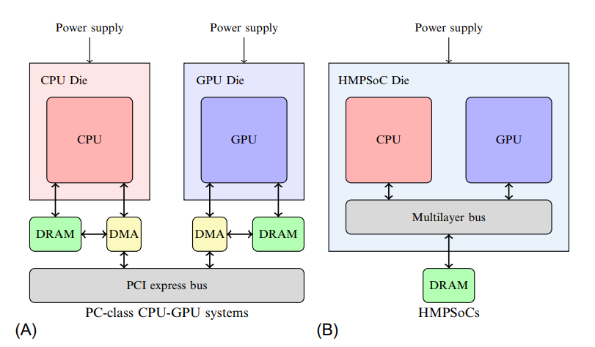
2.5. Power Consumption in GPU :
GPUs consume a lot of power because they have a large number of transistors switching at high frequency.
Digital voltage and frequency scaling DVFS scales the frequency (and voltage) of the GPU to reduce its power consumption. GPU consumes less power at lower frequencies but also provides less performance. DVFS thereby allows a power-performance trade-off. dynamic power management (DPM), that are available for PC-class. GPUs have now made their way to mobile GPUs
Dedicated graphics cards are not just components but a mini ecosystem having their own memory, cooling, power management etc.
2.5.1. Source: https://www.sciencedirect.com/book/9780128037386/advances-in-gpu-research-and-practice
1022_Jayesh Jaiswal, Department of Engineering and Applied Sciences, VIIT, Pune-48

Slide 9
CASE STUDY :
Gaming Laptop for our case study have battery of design capacity = 51,300mWh
Full Charge capacity = 45,338mWh
Transistor Count : 6.4 Billion
Stream Processors :1408
TDP(Thermal Design Power) of GPU of This laptop is 85 W
While doing basic tasks like browsing, watching videos, listening music it takes -primarily use Integrated GPU – 1 to 5W - at 42 Celsius
and a constant use of Dedicated GPU – 1 to 4 W at 44 Celsius. While normal gaming and normal photo editing -
Integrated GPU -- not used primarily
Dedicated GPU – 17 to 24 W temperature - 50- 65 Celsius
while Heavy (AAA) gaming and video Editing -
Dedicated GPU -- 40 to 68 W -- Temperature - 60-72 Celsius.
1022_Jayesh Jaiswal, Department of Engineering and Applied Sciences, VIIT, Pune-48

Slide 10
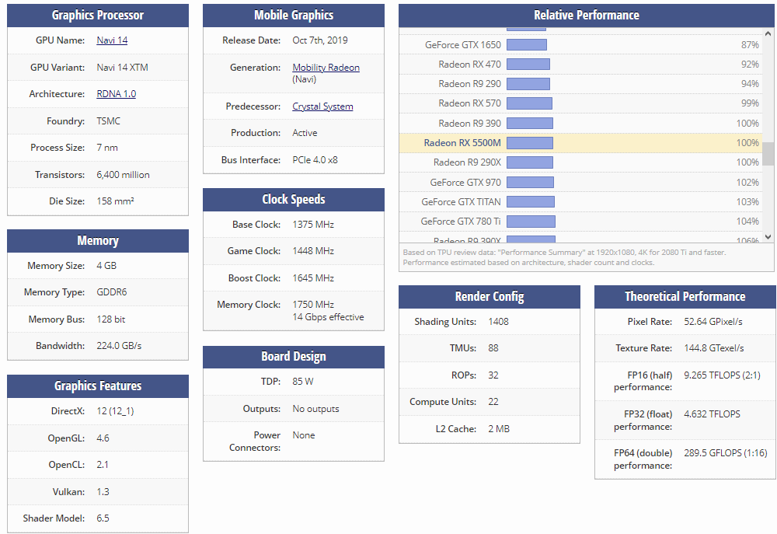
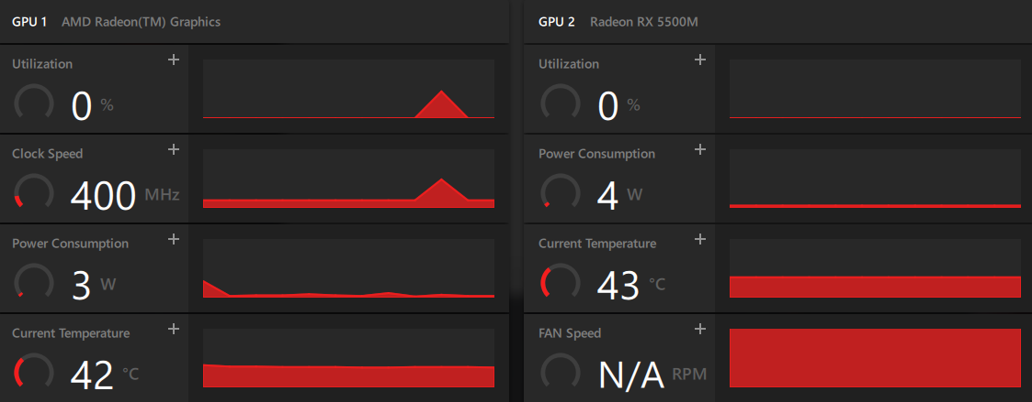
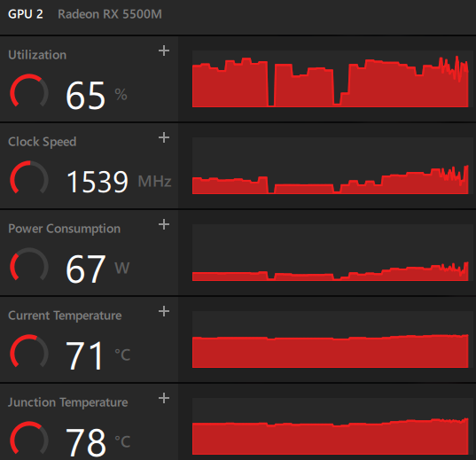
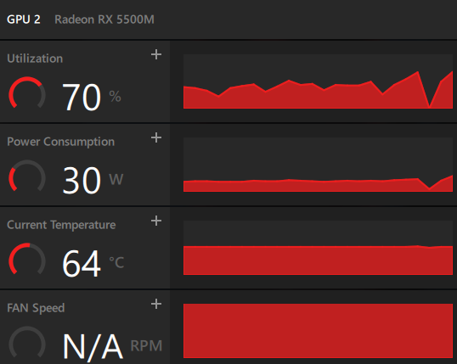
1022_Jayesh Jaiswal, Department of Engineering and Applied Sciences, VIIT, Pune-48

Slide 11
2.6. Methods to reduce power consumption :
The high level power management techniques can be divided into static and dynamic :
Static Power Management (SPM)
Dynamic Power Management (DPM)
a) Hardware Level
i) Dynamic Component Deactivation (DCD) :
ii) Dynamic Voltage and Frequency Scaling (DVFS) :
b) Software Level
i) OS Level
ii) Virtualization Level
iii) Data Centre Level
Diagram 2.6.1: https://www.ijana.in/Special%20Issue/file24.pdf
1024_Omkar Aher, Department of Engineering and Applied Sciences, VIIT, Pune-48

Slide 12
Dynamic Power can be define as -
P dynamic = a.C.V2 .f
Where a is the switching activity, C is the physical capacitance, V is the supply voltage are determined, and f is the clock frequency of CPU.
OS Level : OS also uses power saving techniques like DVFS, Resource throttling, DCD, etc.
Virtualization Level : In this method the virtual machine monitor takes control in the system power management in order to provide efficient operation.
Data Centre Level : The main goal of data centre level is :
✓ Minimize energy consumption, satisfy performance requirements.
✓ Minimize power consumption, minimize performance loss.
1024_Omkar Aher, Department of Engineering and Applied Sciences, VIIT, Pune-48

Slide 13
3. Conclusions :
1) We have studied and classified different ways to achieve power and energy efficiency in computing systems. The recent developments have been discussed and categorized over the hardware, operating system, virtualization and data centre levels.
2) Our analysis resulted in an estimation of a power consumption value for each scenario and software application used, obtaining that each single scenario introduced an overhead from 2 to 11 Watts, corresponding to an increase of about 12%.
3) Energy savings opportunities include improved power management (defaulting to low-power modes after inactivity as well as power scaling), matching the rated power of power supplies to computing needs, and improving the efficiency of individual components.
4) The GPU is among the most power draining hardware, so it should pe installed only if user is in its need. Also the technologies like DPM and DVFS should be used which can do power-performance trade-off.
5) In CPU, the major amount of energy is lost in dissipated as heat while computational work is done.
6) In all types of LEDs (i.e. TN, VN, IPS) TN consumes the most, VN consumes less as compared to TN. IPS consumes the least amount of power among all three types.

Slide 14
4. References :
Computer usage and national energy consumption:Results from a field-metering study (escholarship.org)
Laptop and Desktop energy comparison : Bijli Bachao
WATT You Should Know About Processor Power (onlogic.com).
Radeon HD 5830 Power Requirements (chron.com)
https://eprints.mdx.ac.uk/29778/1/Power%20Consumption%20of%20the%20Raspberry%20Pi_CameraReady.pdf
https://www.onlogic.com/company/io-hub/watt-know-processor-power/
https://smallbusiness.chron.com/radeon-hd-5830-power-requirements-66922.html
https://energyusecalculator.com/electricity_lcdleddisplay.htm
https://www.tomshardware.com/reviews/tn-panel-twisted-nematic-definition,5767.html
https://superuser.com/questions/148070/where-does-power-consumption-go-in-a-computer
https://electronics.stackexchange.com/questions/79166/where-does-all-the-power-consumed-by-a-cpu-go#:~:text=In%20other%20words%2C%20no%20net,capacitance%20of%20other%20internal%20transistors.
https://electronics.stackexchange.com/questions/511785/why-does-gpu-consume-so-much-power#:~:text=GPUs%20consume%20a%20lot%20of,not%20require%20as%20much%20power.
https://computerinfobits.com/why-is-my-gpu-so-hot/#:~:text=Your%20GPU%20is%20probably%20so,tries%20to%20complete%20intense%20tasks.
https://www.ijana.in/Special%20Issue/file24.pdf
https://www.intel.in/content/www/in/en/it-management/intel-it-best-practices/green-computing-at-scale-paper.html?wapkw=Green%20Computing%20Techniques%20to%20Power%20Management%20and%20Energy%20Efficiency
M. Weiser, “The computer for the 21st century,” Scientific American, vol. 265, no. 3, pp. 94-104, 1991.
J. G. Koomey, ―Estimating total power consumption by servers in the US and the world,‖ Oakland, CA: Analytics Press. February 15, 2007.

Slide 15
THANK YOU !

